Slide 1
32 Practice Citing Sources (Blank)-28_eng_rw_v6.pptx
The following 10 white slides give places to cite a footnote, a later footnote repeated in short form, and the Bibliography entry for the source cited. See the pictures of the source, including the last picture for that source that shows the page you want to cite. Then put that information into the white slide in the proper format. Find this correct format at the “SBC Writing Standards” (WS) section noted at the top of the white slide.
¹ Note
⁵ Repeat
Bibliography

Slide 2
1: Book with One Author (WS 5.1)
¹ Note
⁵ Repeat
Bibliography

Slide 3



Slide 4
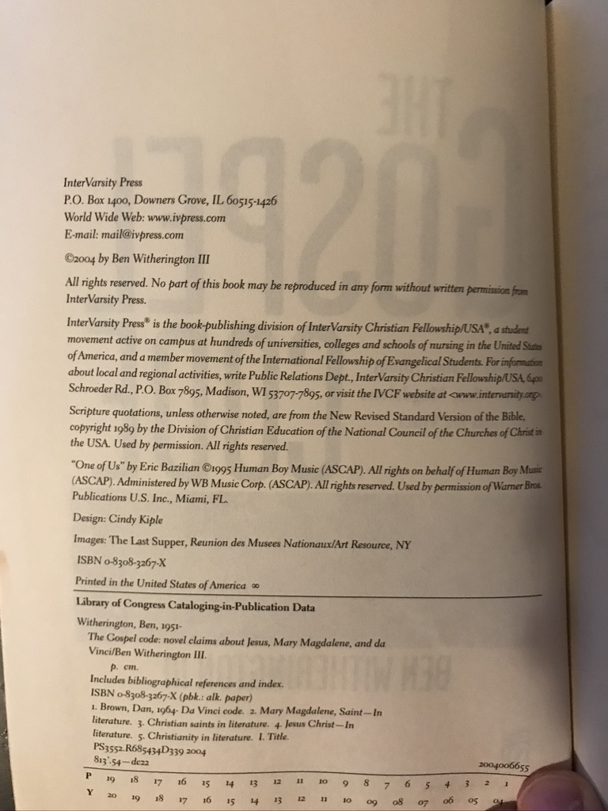
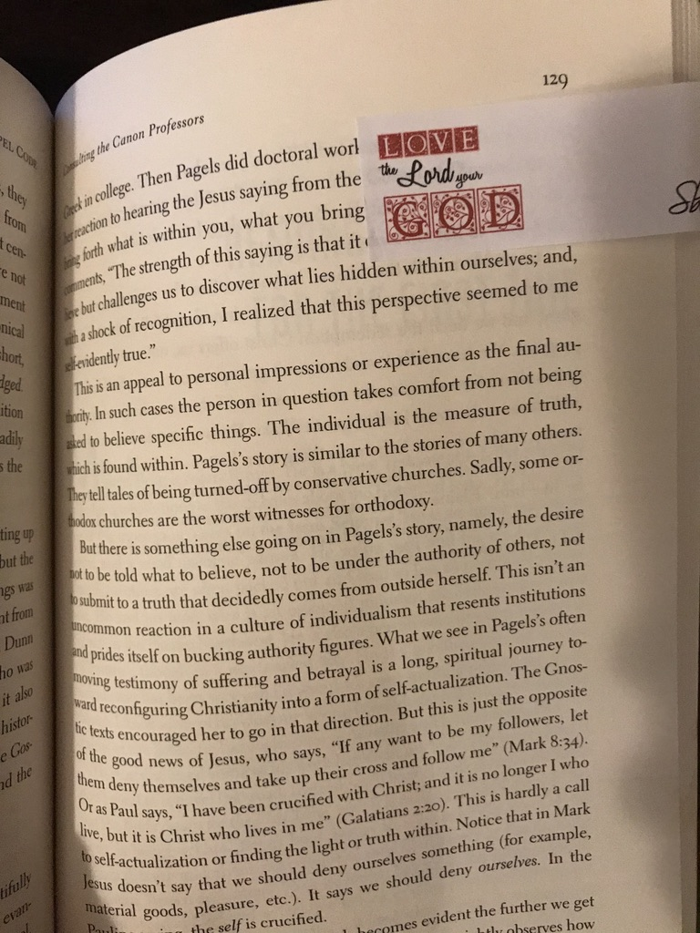

Slide 5
2: Book with Two Authors (WS 5.2)
¹ Note
⁵ Repeat
Bibliography

Slide 6



Slide 7
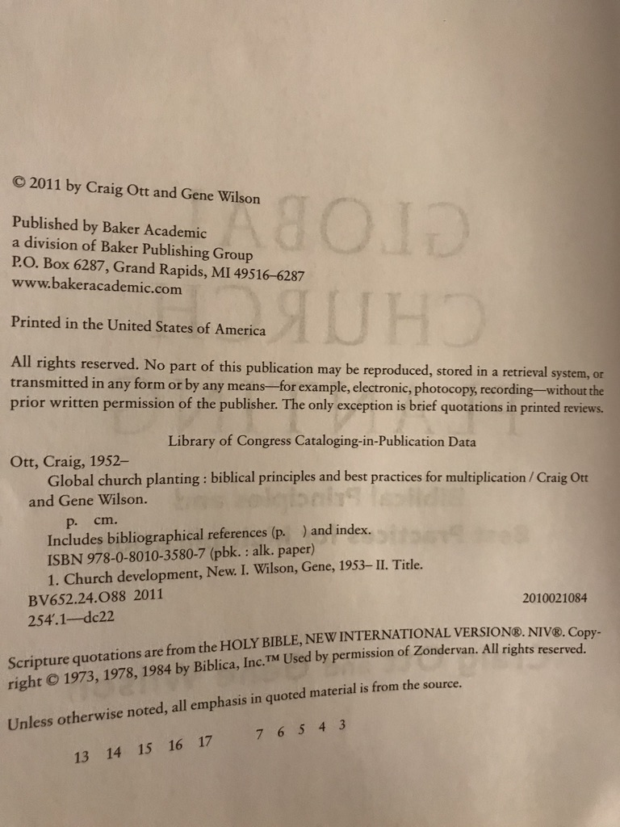
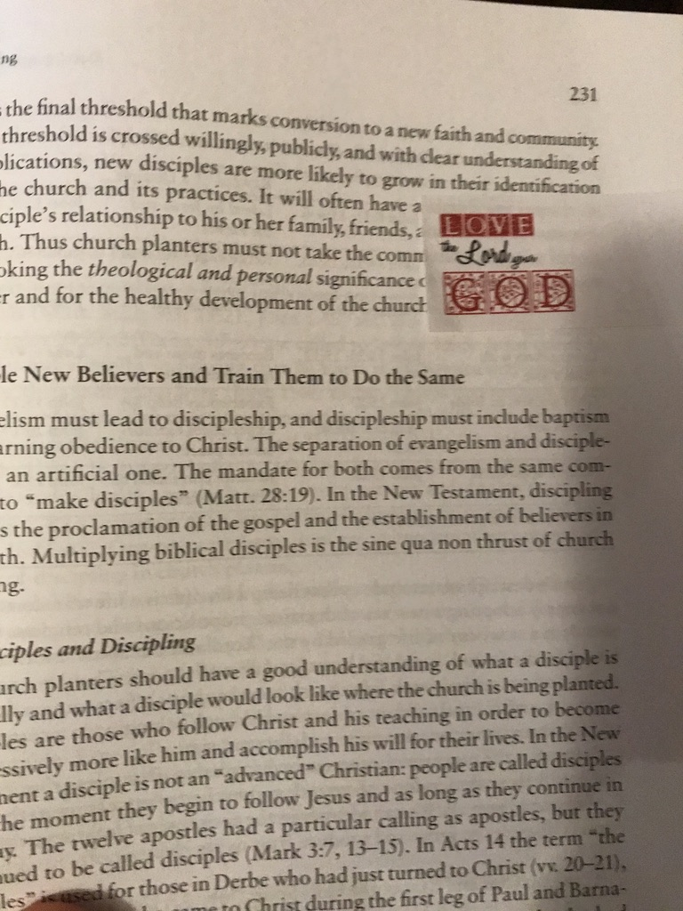

Slide 8
3: Book with Author & Editor (WS 5.14)
¹ Note
⁵ Repeat
Bibliography

Slide 9



Slide 10
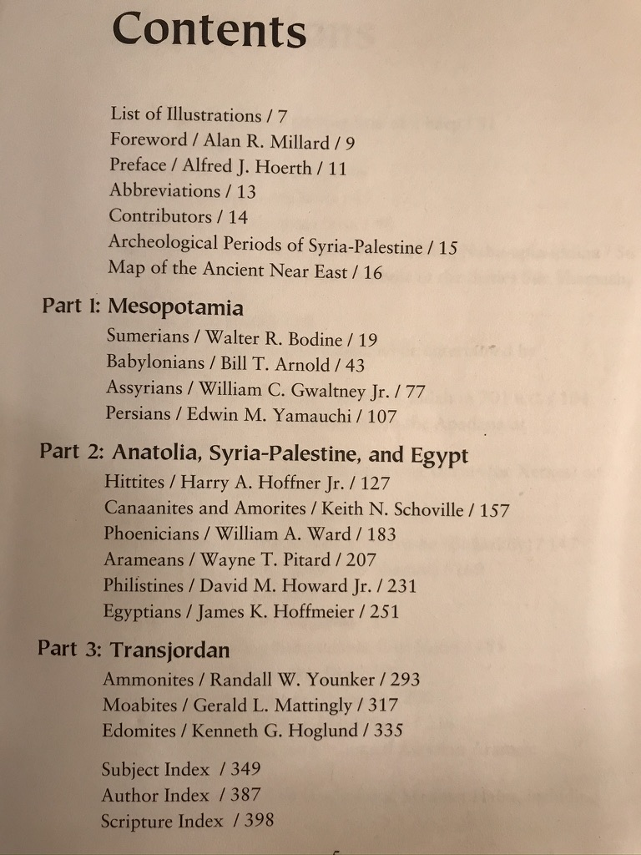
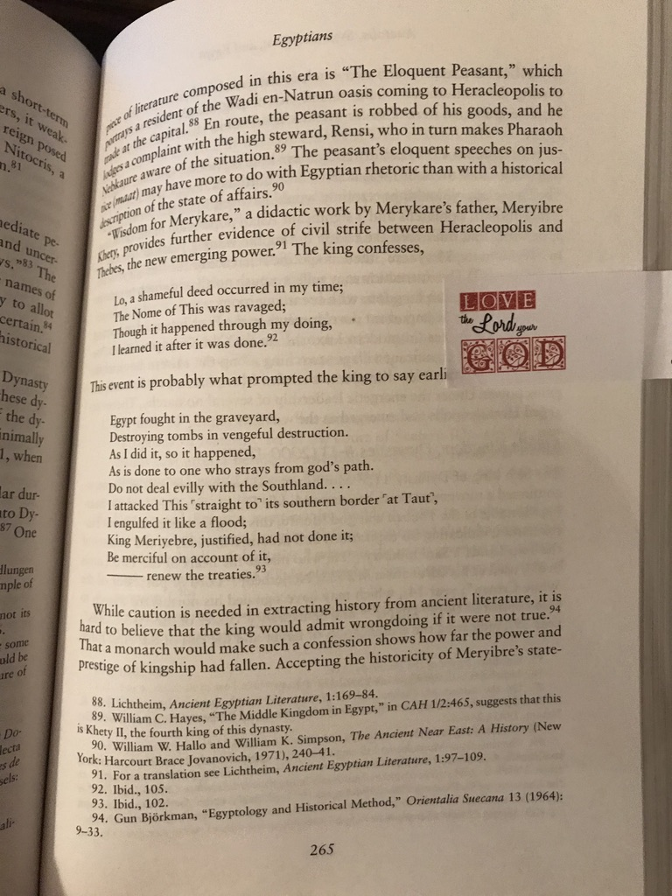

Slide 11
4: Book of Primary Sources (WS 5.36)
¹ Philo
⁵ Repeat
Bibliography

Slide 12



Slide 13
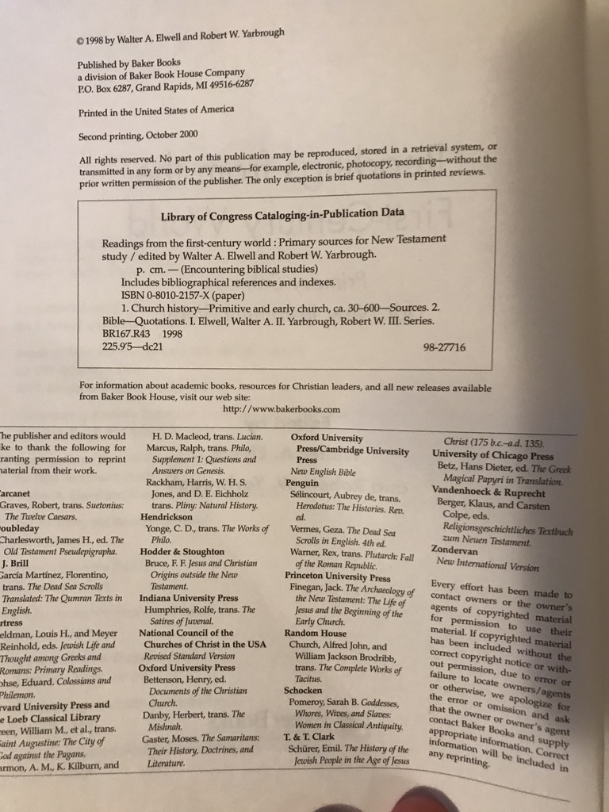
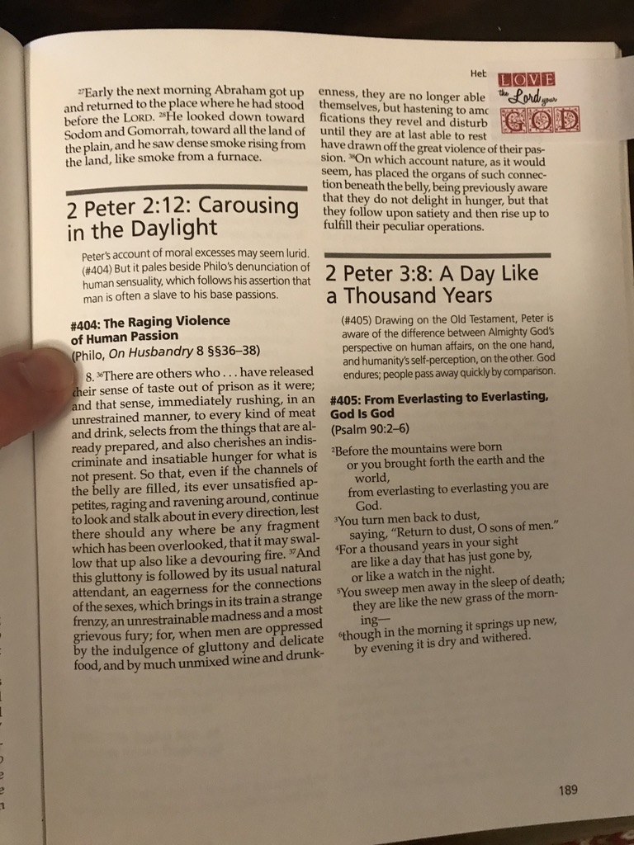

Slide 14
5: Greek Lexicon with BibleWorks Greek Font (WS 5.24)
¹ "poiki,loj,”…
⁵ Repeat
Bibliography

Slide 15



Slide 16
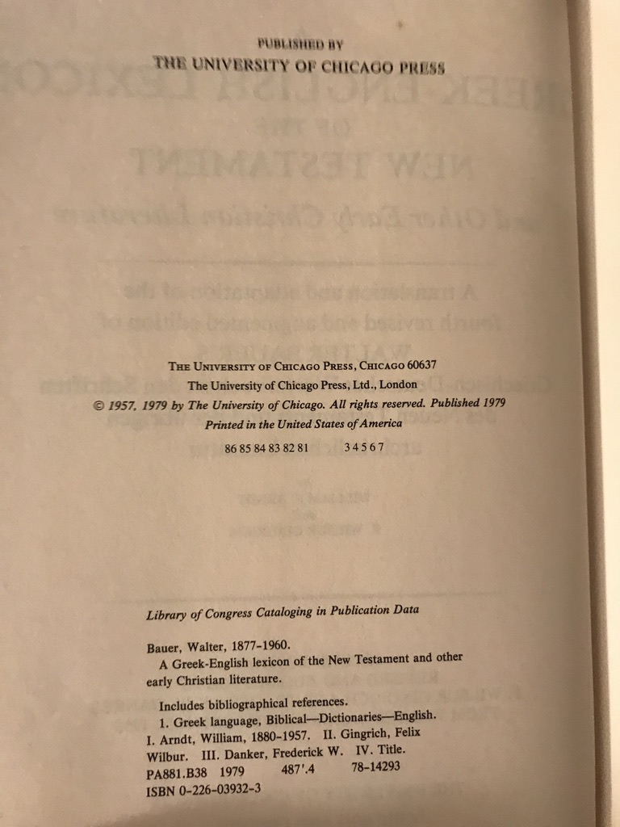
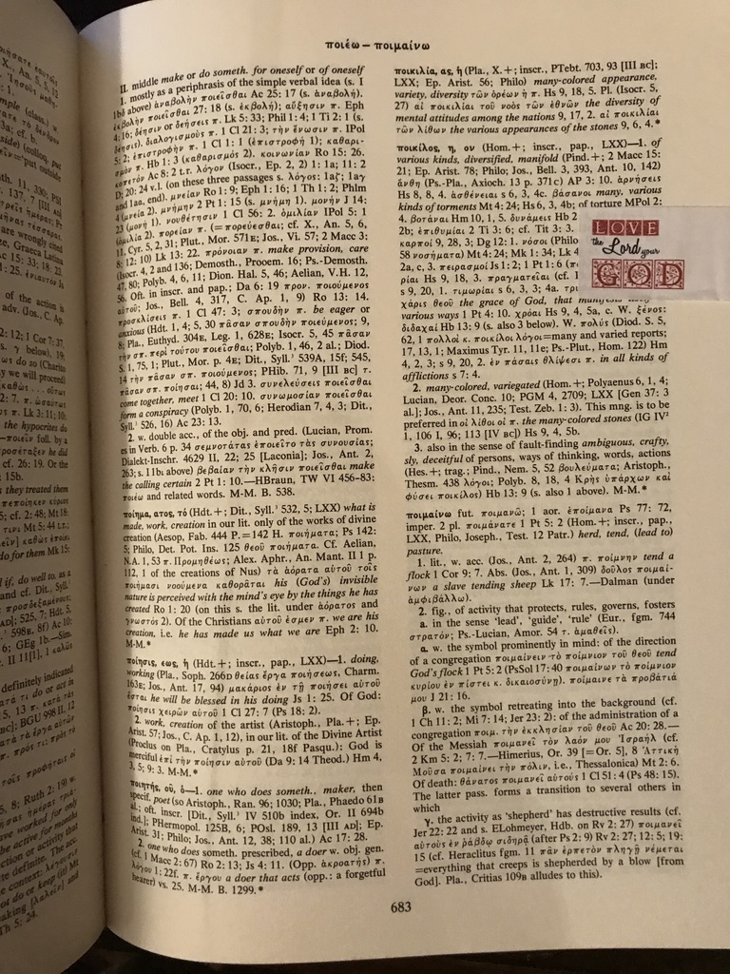

Slide 17
6: Hebrew Lexicon with BibleWorks Hebrew Font (WS 5.24)
¹ Note
⁵ Repeat
Bibliography

Slide 18
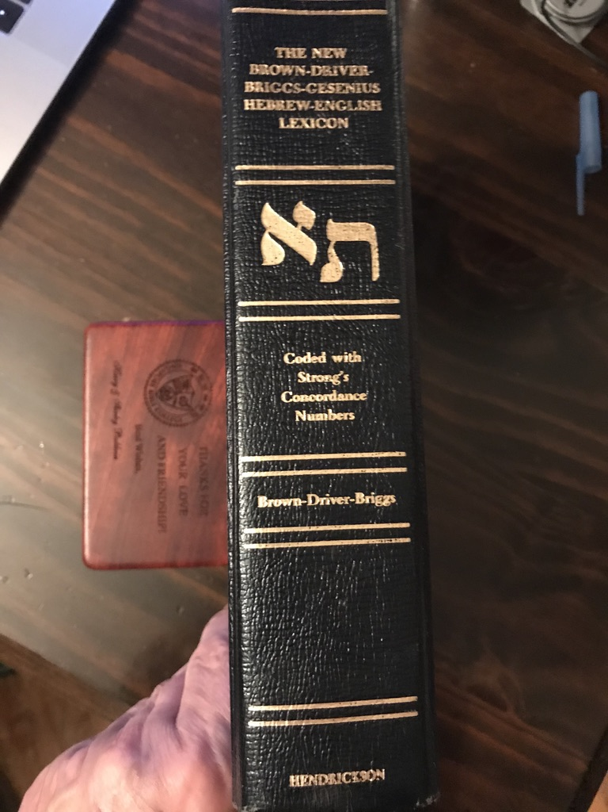
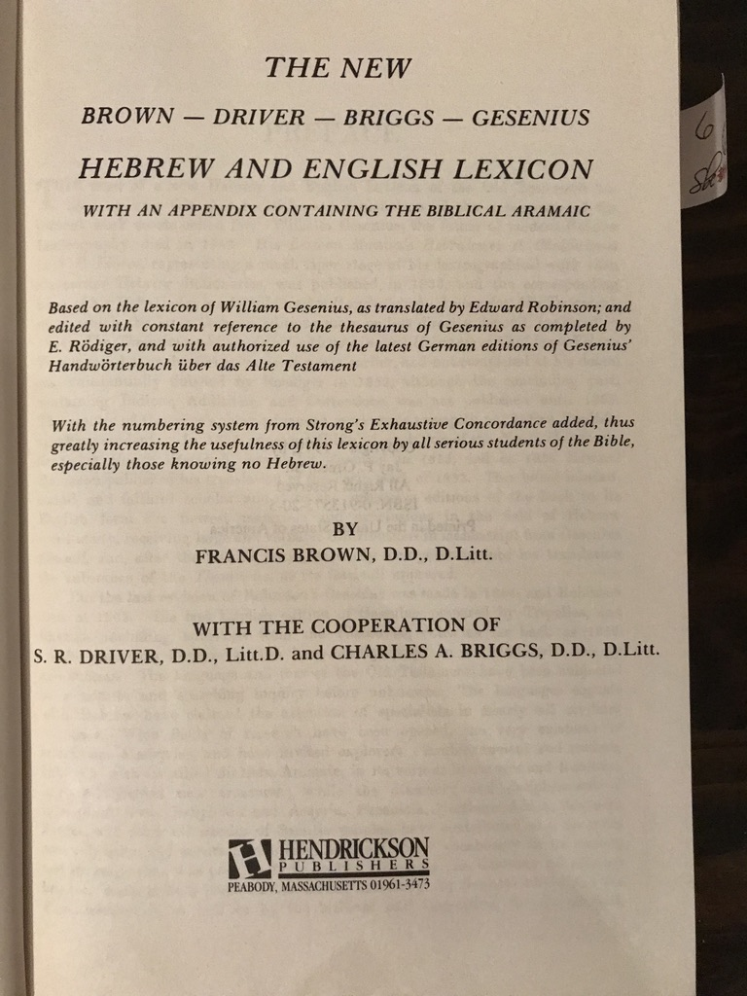

Slide 19
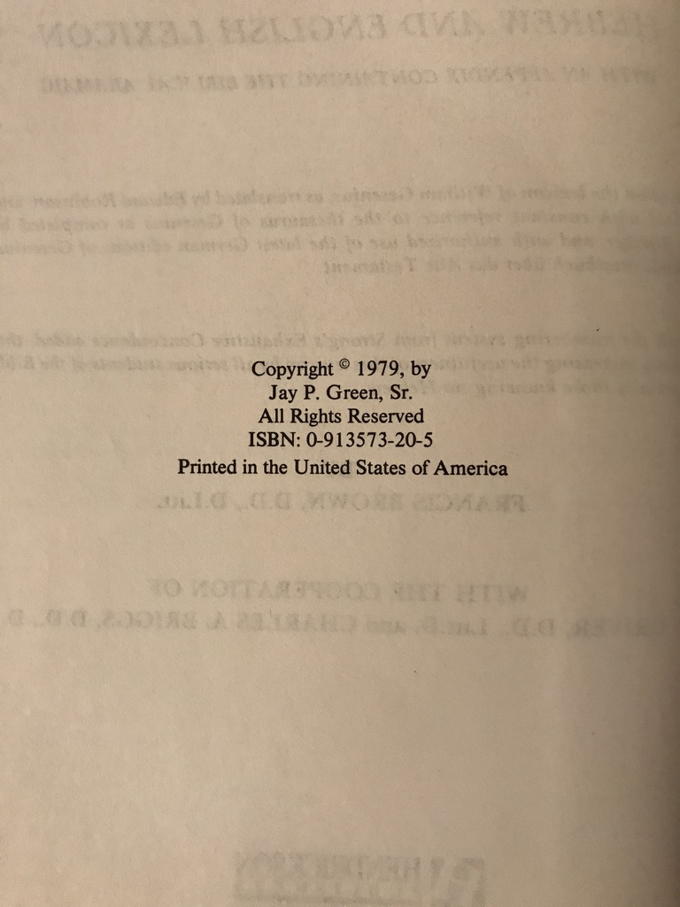
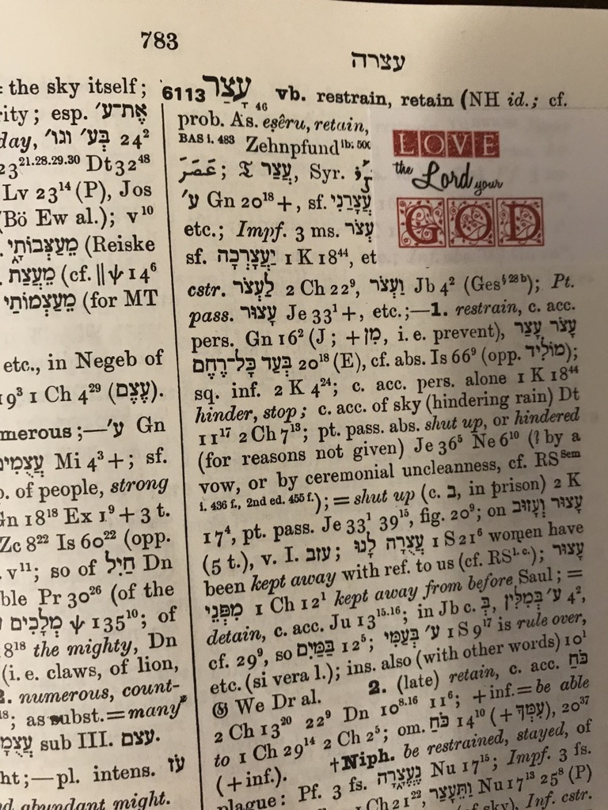

Slide 20
7: Journal Article with One Author (WS 5.13)
¹ Note
⁵ Repeat
Bibliography

Slide 21
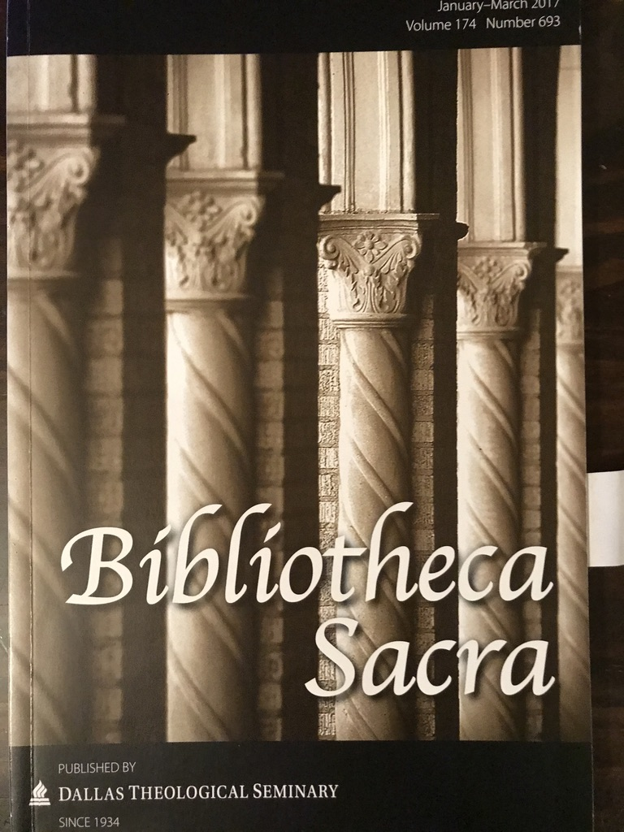
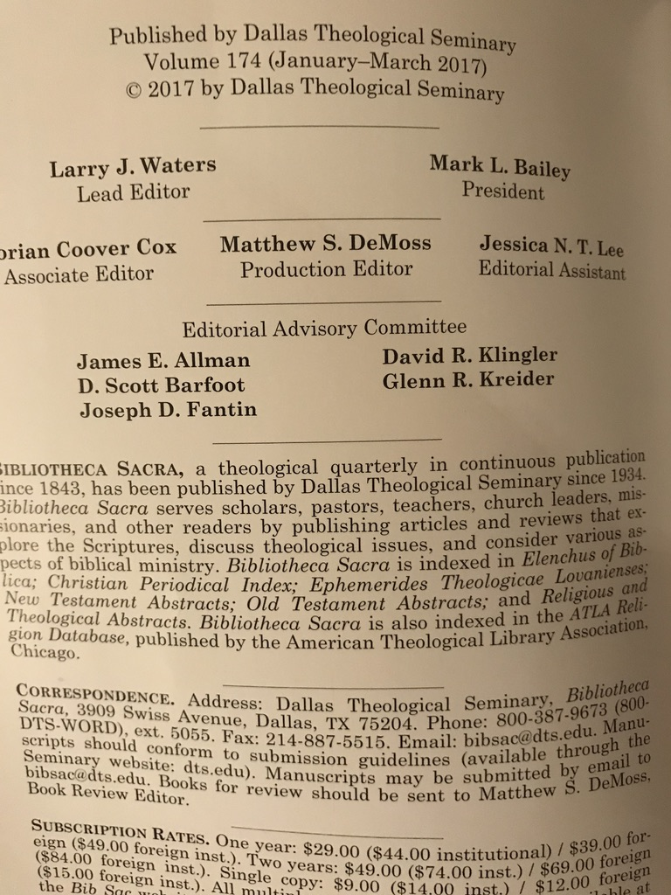

Slide 22
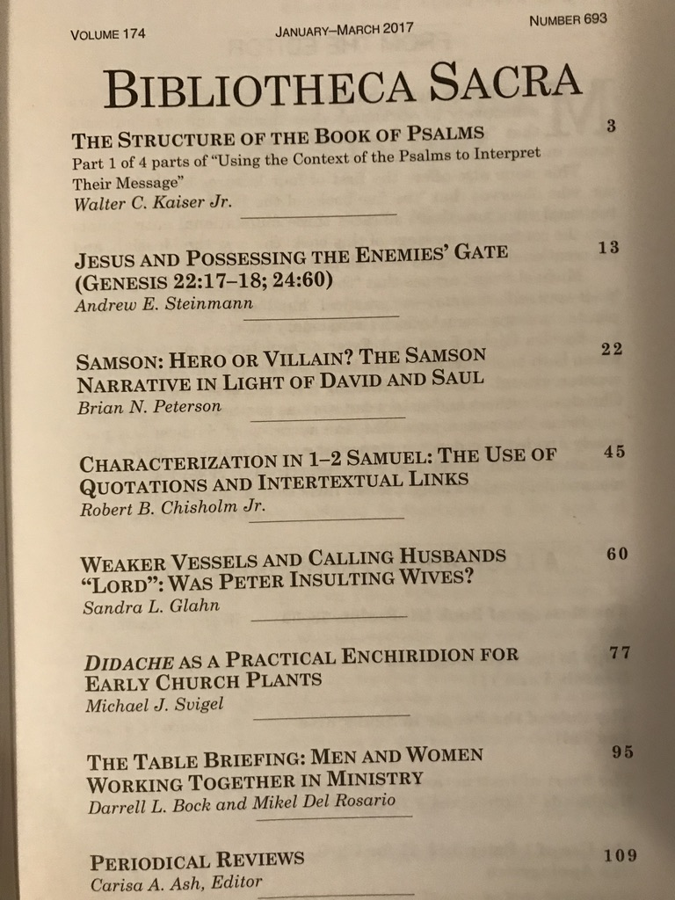
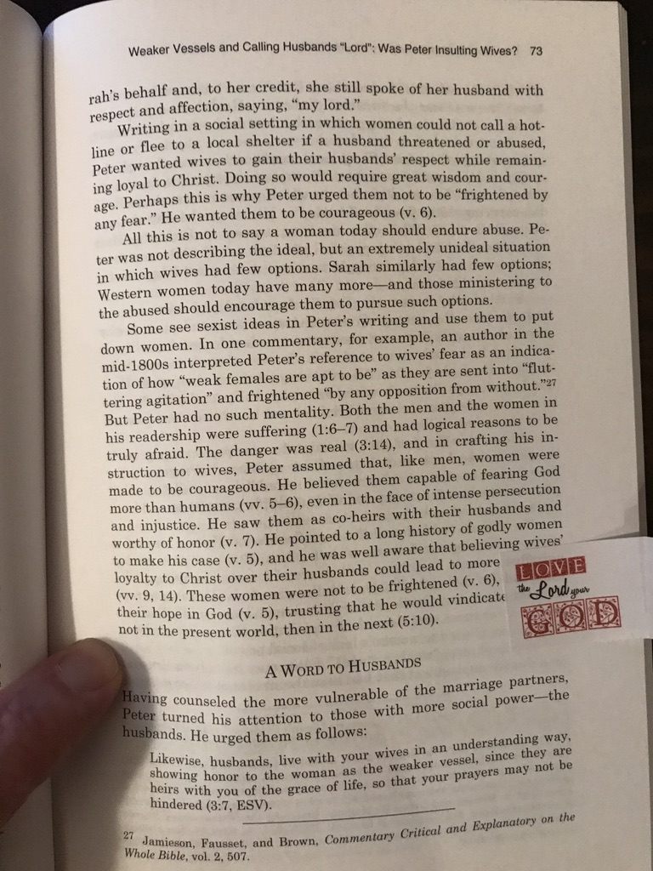

Slide 23
8: Journal Book Review (WS 5.22)
¹ Note
⁵ Repeat
Bibliography

Slide 24
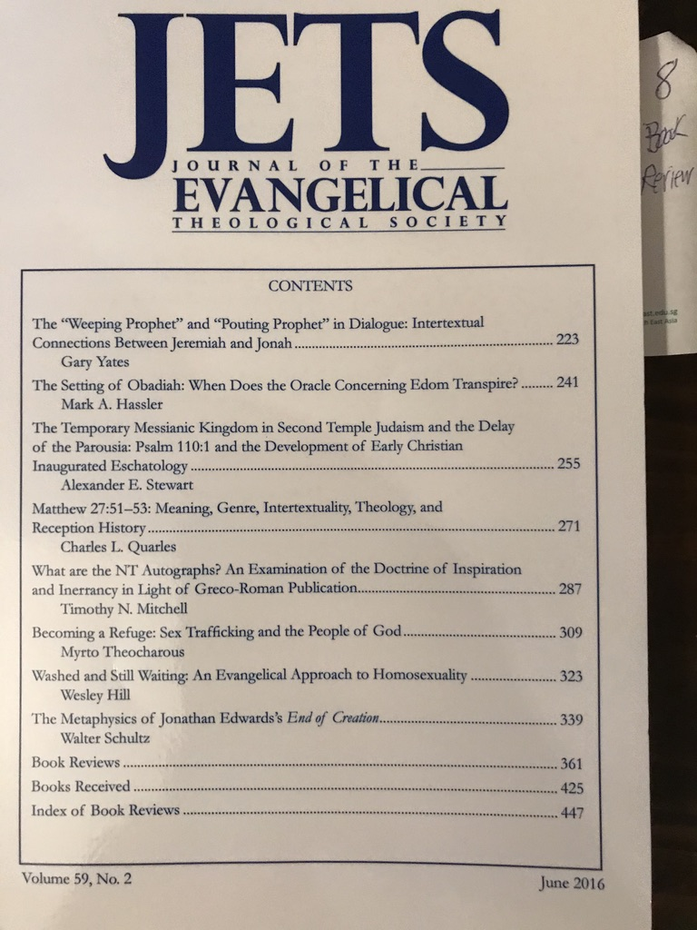


Slide 25
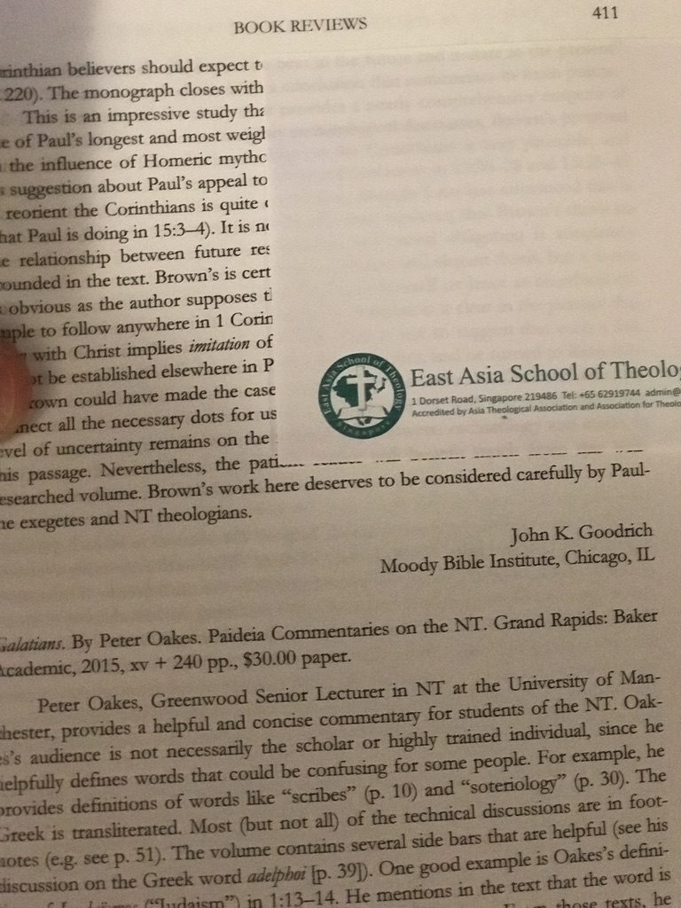
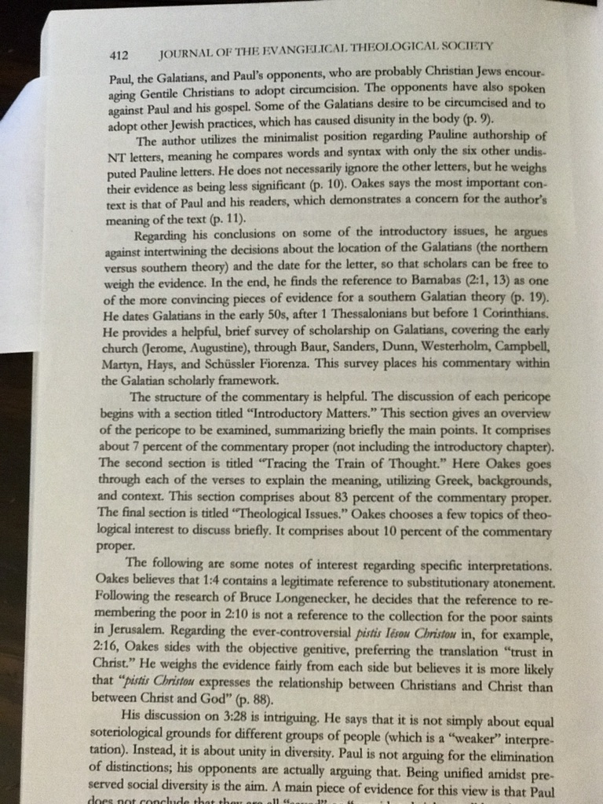

Slide 26
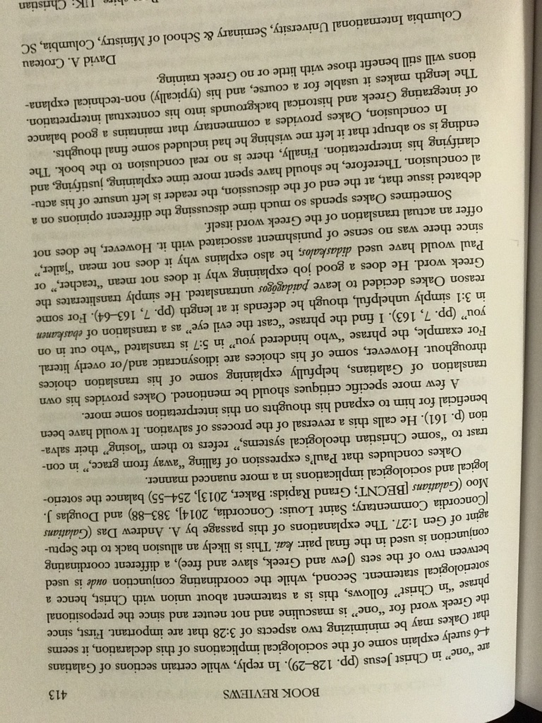

Slide 27
9: Website Text (WS 5.29)
¹ Note
⁵ Repeat
Bibliography
http://www.startingfresh.net/11.html

Slide 28
10: Website Download (WS 5.31)
¹ Note
⁵ Repeat
Bibliography
http://www.biblestudydownloads.org/resource/old-testament-survey/
Ezra slide 15

